Slide 1
Results
High Traffic + Near Tech Hubs
High Traffic
High Traffic + Near Tech Hubs
Near Tech Hubs

Slide 2
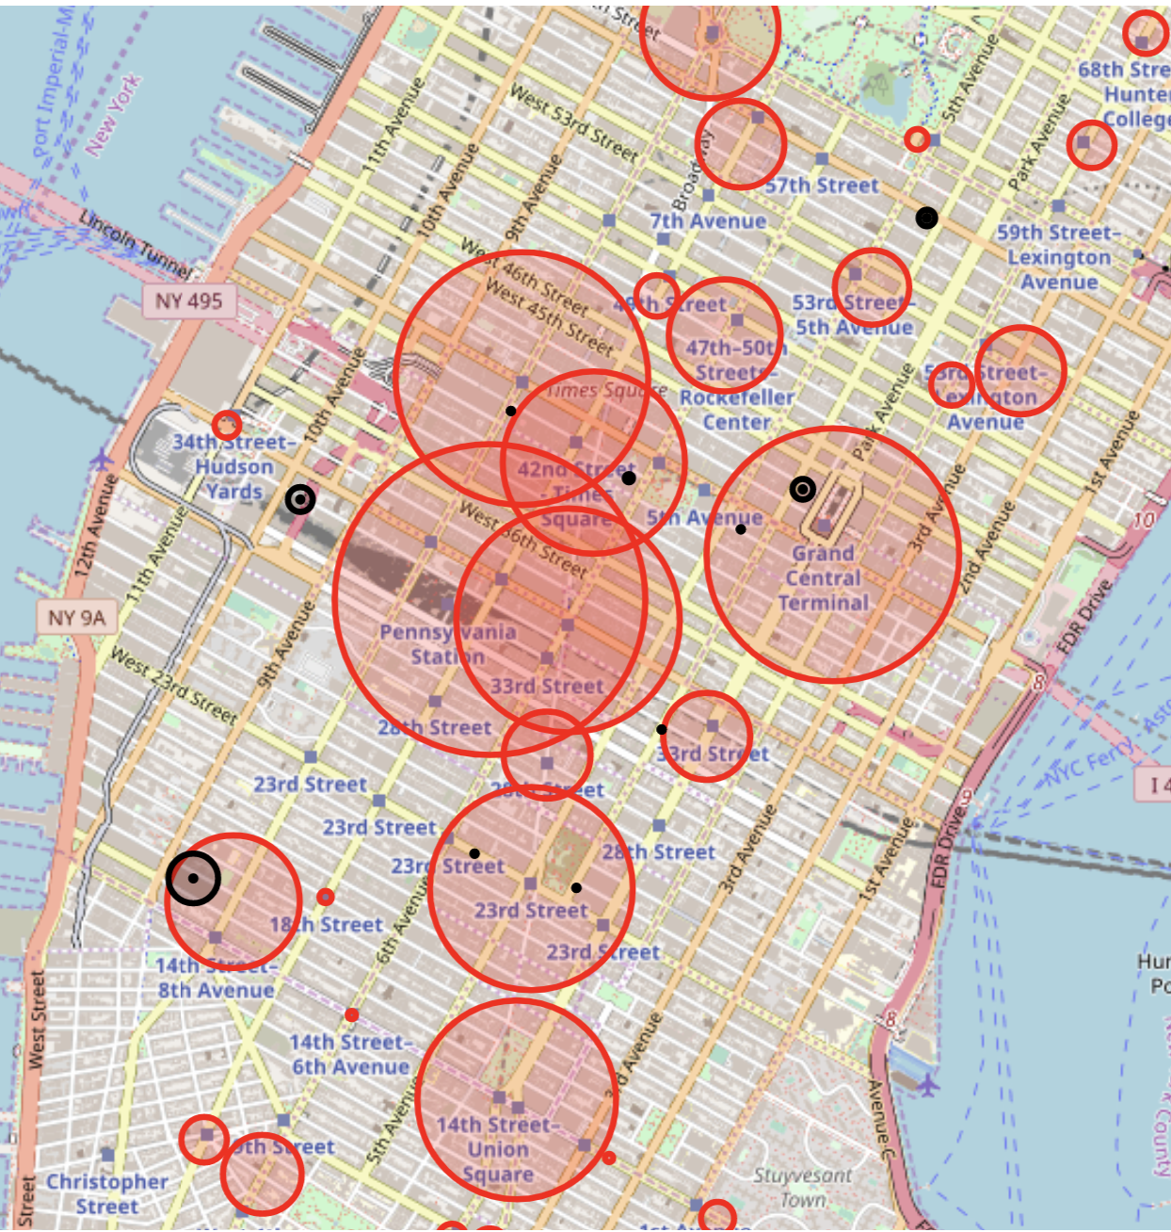
Results
High Traffic + Near Tech Hubs
Grand Central
High Traffic + Near Tech Hubs
86th St
Notes:
Subway Station Traffic: by Average Daily Turnstile “Entrances”
Technology Companies (sample of 15 locations): by square footage
Technology Schools (NYC, CUNY [New York City College of Technology, NYIT]): by student population size
Assumptions of using Subway Traveler Volume:
Every subway rider has an equal likelihood of attending & contributing
Weekly commuter patterns in Spring 2019 are consistent with Spring 2020
To address the limitations of relying on the MTA data alone, we looked to multiple sources to identify the “Tech Hubs”
Using the locations of the stations and the “Tech Hubs”, we were able to narrow our results
Preliminary results:
Here are some preliminary results we found, as a taste of what we can do.
Most overall traffic:
Let’s start at the start and simply see where the most traffic is. This has a lot of assumptions baked into it, so we’ll examine these and refine our recommendations as we continue.
Top five stations in terms of average daily turnstile entrances:
34th St - Penn Station
42nd St - Grand Central Station
34th St - Herald Square
14th St - Union Sq
42nd St - Times Sq
[make a table or chart to put here instead of list]

Slide 3
Results
34th St - Penn Station
42nd St - Grand Central Station
42nd St
34th St - Herald Square
23rd St
14th St - Union Sq
Notes:
Subway Station Traffic: by Average Daily Turnstile “Entrances”
Technology Companies (sample of 15 locations): by square footage
Technology Schools (NYC, CUNY [New York City College of Technology, NYIT]): by student population size

Slide 4
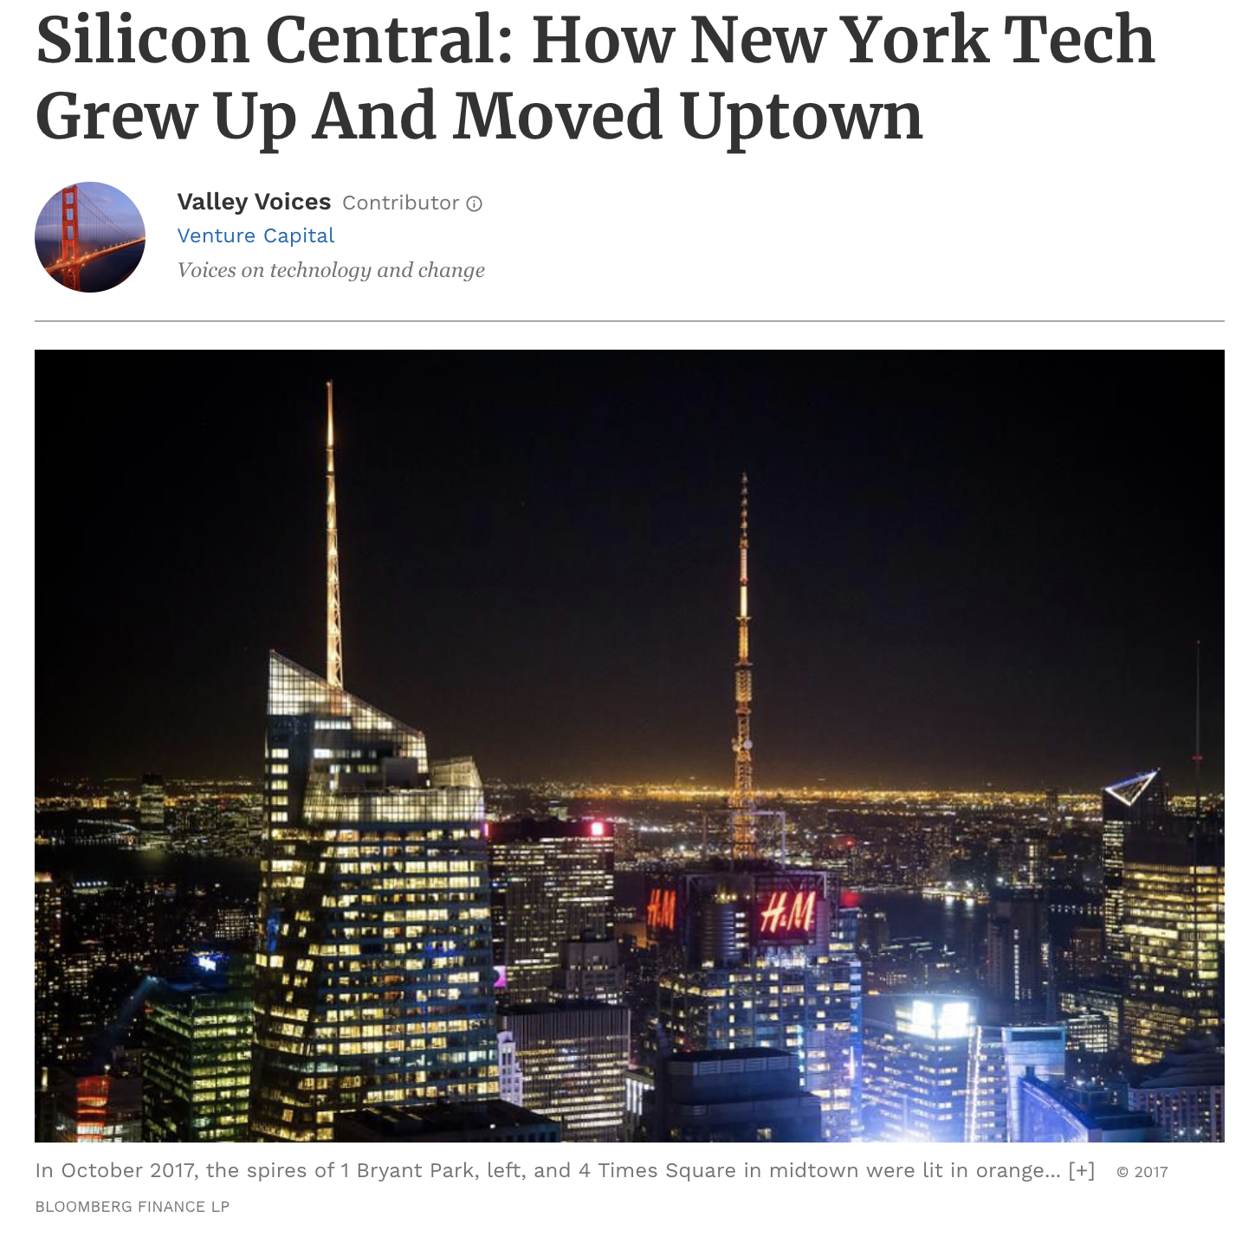
Appendix
https://www.forbes.com/sites/valleyvoices/2019/03/27/how-new-york-tech-grew-up-and-moved-uptown/#f73ff9b41bfd
Notes:
Flatiron District – notable businesses
Some businesses have moved to the blocks circumventing Bryant Park and Grand Central Terminal, which the author dubbed as ‘Silicon Central’

